Slide 1


A Major Project on An Implementation of Blockchain Technology in Forensic Evidence Management
Under the Guidance
of
RAHEEM UNNISA
(Assistant Professor)
BY
G.VIDYADHARI (197R1A05L2)
E.SHIVANI (197R1A05K7)
D.SUMANTH (197R1A05K6)

Slide 2
ABSTRACT
Evidence management is crucial in the field of forensic science. Evidences obtained from a crime scene are important in solving the case and delivering justice to the parties involved. Hence, protecting these evidences from any form of alteration is of utmost important. Chain of Custody is the process which maintains the integrity of evidence. Inability to maintain the chain of custody will make the evidence inadmissible in court, eventually leading to the case dismissal. Digitalization of forensic evidence management system is a need of time as it is an environment friendly model. Blockchains are digitally distributed ledgers of transactions signed cryptographically in chronological order that are sorted into blocks and is completely open to anyone in the blockchain network. Hyperledger Fabric is a consortium blockchain framework created by the Linux foundation and is mainly used for enterprise use. Based on the concept of Hyperledger Fabric, present study aimed to create a framework and further propose an algorithm to implement Blockchain Technology to digitalize forensic evidence management system and maintain Chain of Custody.

Slide 3
EXISTING SYSTEM
Evidence management is critical in the field of forensic science. Main concerns in forensic investigation are the management of evidences and their documentation. Starting from the point of collection till the final judgment from the court of law, maintaining the integrity of the evidence is of utmost importance . Evidences obtained from a crime scene are important in solving the case and delivering justice to the parties involved.

Slide 4
PROPOSED SYSTEM
Chain of Custody is the process which maintains the integrity of evidence. Inability to maintain the chain of custody will make the evidence inadmissible in court, eventually leading to the case dismissal. Digitalization of forensic evidence management system is a need of time as it is an environment friendly model. Blockchains are digitally distributed ledgers of transactions signed cryptographically in chronological order that are sorted into blocks and is completely open to anyone in the blockchain network. Hyperledger Fabric is a consortium blockchain framework created by the Linux foundation and is mainly used for enterprise use. Based on the concept of Hyperledger Fabric, present study aimed to create a framework and further propose an algorithm to Implement.

Slide 5
ADVANTAGES
Blockchain Technology to digitalize forensic evidence management system and maintain Chain of Custody.
Hence, protecting these evidences from any form of alteration is of utmost important.

Slide 6
DISADVANTAGES
Problem in solving the case and delivering justice to the parties involved.

Slide 7
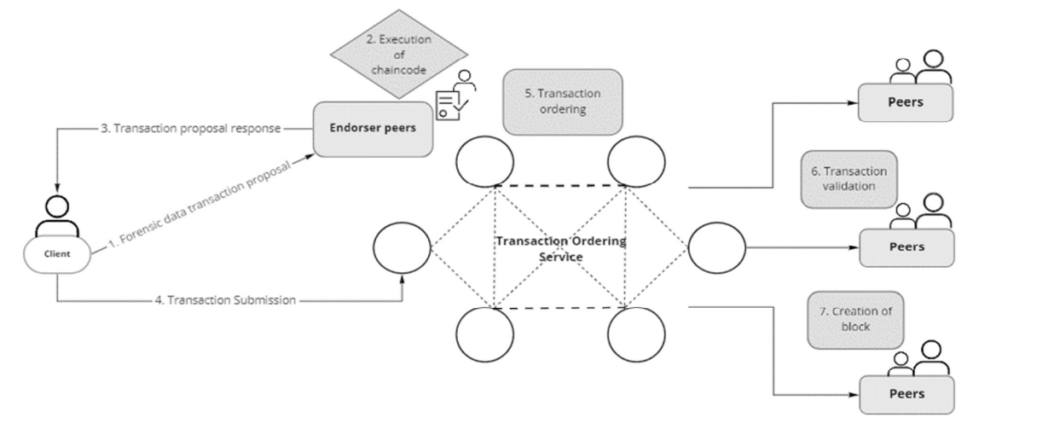
ARCHITECTURE

Slide 8
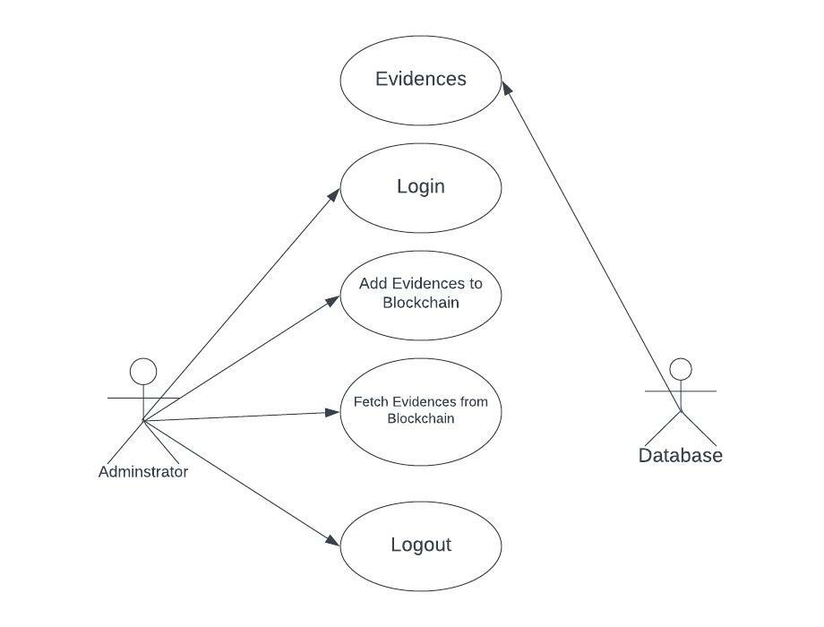
USE CASE DIAGRAM

Slide 9
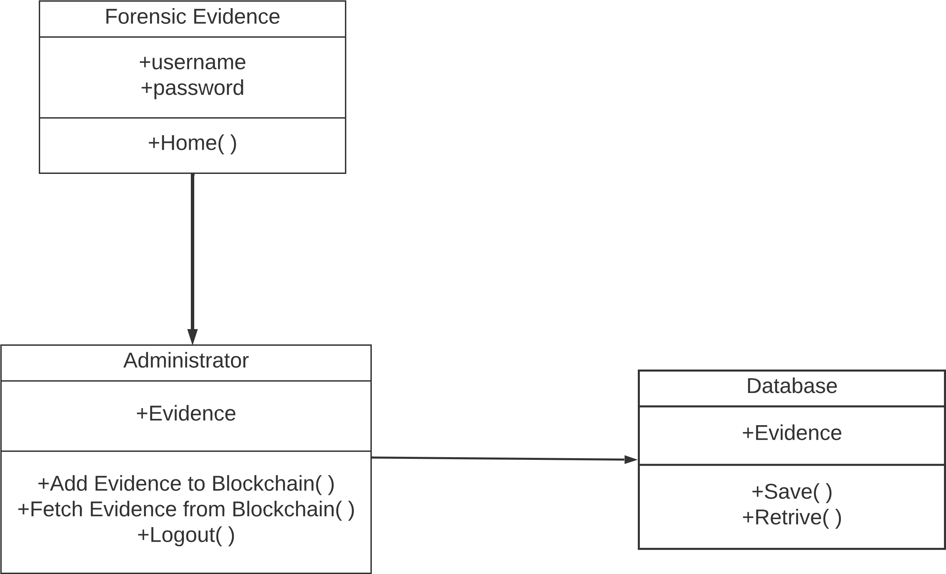
CLASS DIAGRAM

Slide 10
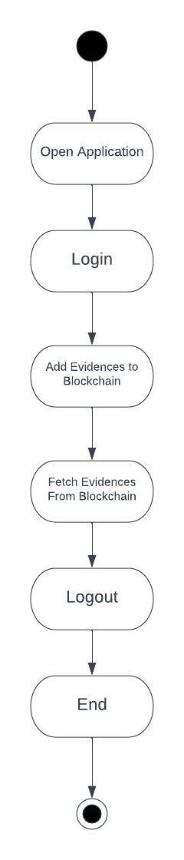
ACTIVITY DIAGRAM

Slide 11
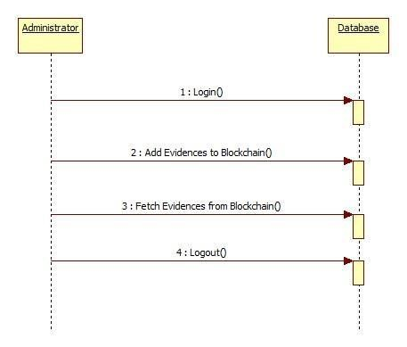

SEQUENCE DIAGARM

Slide 12
REQUIREMENTS
HARDWARE REQUIREMENTS:
Operating system : Windows, Linux
Processor :Minimum intel i3
Ram : Minimum 4gb
Hard disk : Minimum 250gb

Slide 13
REQUIREMENTS
SOFTWARE REQUIREMENTS:
Python idel 3.7 version (or)
Anaconda 3.7 ( or)
Jupiter (or)
Google colab

Slide 14
NOVELTY
Evidence management is critical in the field of forensic science. Main concerns in forensic investigation are the management of evidences and their documentation. Starting from the point of collection till the final judgment from the court of law, maintaining the integrity of the evidence is of utmost importance. Chain of Custody (CoC) is the documentation of the evidences handled throughout the investigation in chronological order. It is essential to maintain the CoC for the evidence to be accepted in court. Digitalization of forensic evidence management system saves space and at the same time makes it environment friendly and cost-efficient. Authenticity and legitimacy of CoC make evidence admissible in the court of law. These can be maintained by using blockchain technology. Blockchain technology enables us to store various details of a system within a single network making it secure and accessible to its users. Reviewing the documents in physical format can be time consuming which can be minimized by utilizing the technology.

Slide 15
CONCLUSION
From the time evidence is collected from the crime scene until court of law make the judgment, maintaining the integrity of the evidence is of most importance. Maintaining the chain of custody is important as it can prove if the evidence is tampered or not during the collection and analysis process. Implementation of Blockchain technology to digitalize chain of custody will ensure security, authenticity and integrity of the forensic data transactions. Application of blockchain will not only make it environment friendly but also increase security with the help of encryption which can be accessed remotely by authorized personnel. We intend to work on an algorithm that executes the chain of custody process utilizing blockchain technology, specifically Hyperledger Fabric. Furthermore, we can couple blockchain technology with artificial intelligence/ machine learning which will help in forensic investigation.

Slide 16
THANK YOU

